Slide 1


To Do List
Presentation On
By Group-10

Slide 2
Submitted To Mrs. Atia Binti Aziz Adjunct Lecturer Dept. of CSE, IIUC
Submitted By
Team leader:
Tehsim Fariha (C193207)
Team members:
Nujhat Tabassum(C193203)
Sadiya Afrin Priya (C193228)

Slide 3

Introduction
To Do List is a list of tasks We need to complete or things that what we want to do.

Slide 4
Objectives
To provide solution for user to organize and manage their task.
Simple and Easy for all user
Easy to maintain
It is very user friendly.

Slide 5
Features
To Do List System bears the following functions to use by the Users:
Add item in list
Display the list
Delete specific item from the list
Exit from the To Do List

Slide 6


Development Tools
Software used : Apache NetBeans IDE 15
Programming Language: Java
For storing Data: File system

Slide 7
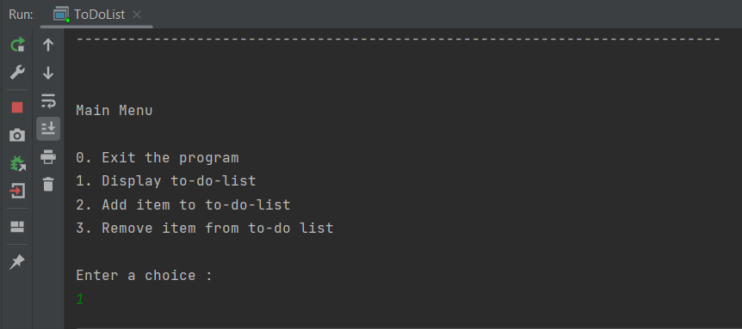
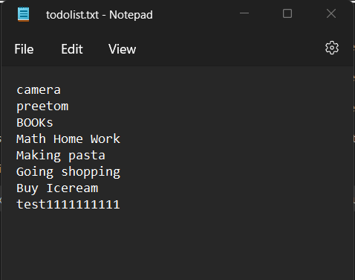
Input & Output System
Console based input system
Input will be taken from the user by keyboard in Console
Output will be shown in output File as well as in Console
Input in Console
Output in File

Slide 8

Block Diagram
Exit Program Menu
Display List Menu
Add List Menu
Delete Item Menu
Menu
Process
Output

Slide 9
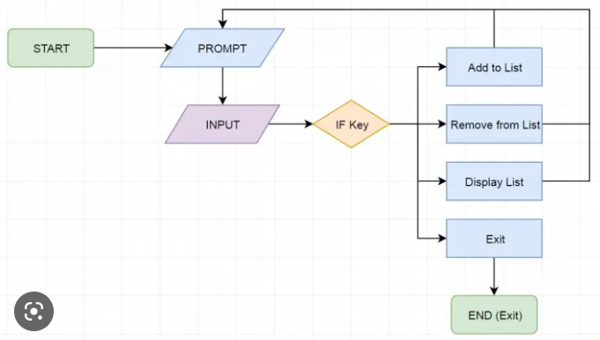
Flowchart

Slide 10
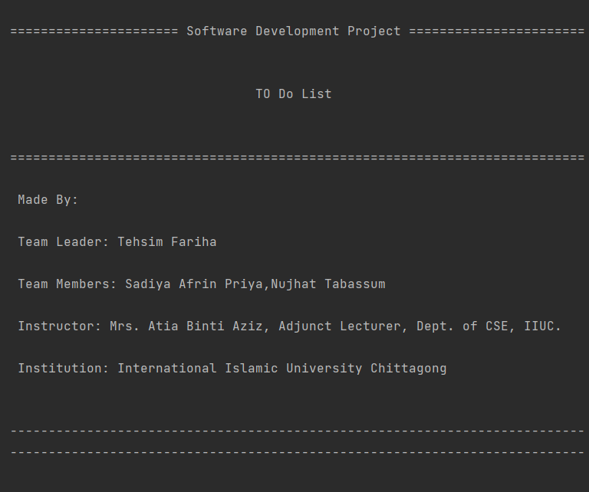
Output

Slide 11
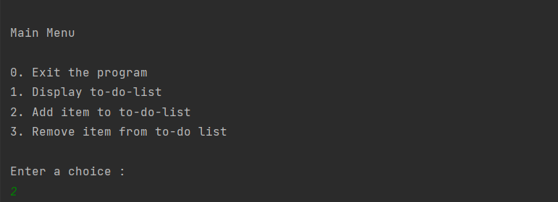

Main Menu
Add item

Slide 12
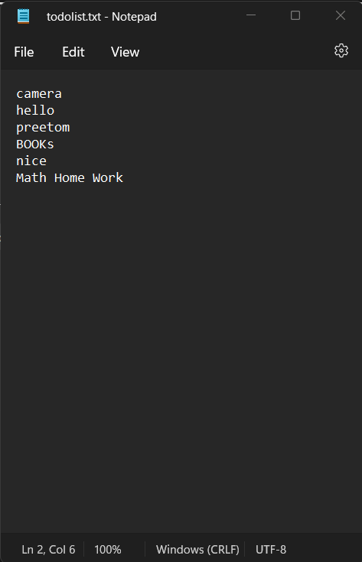
Item added in todolist.txt File

Slide 13
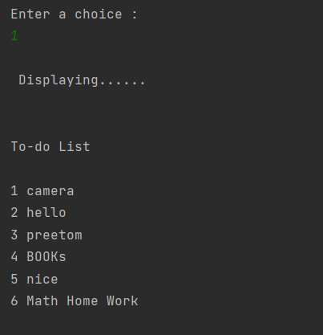
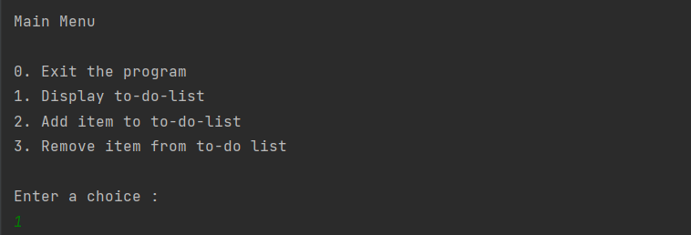
Displaying List
Choice Menu

Slide 14
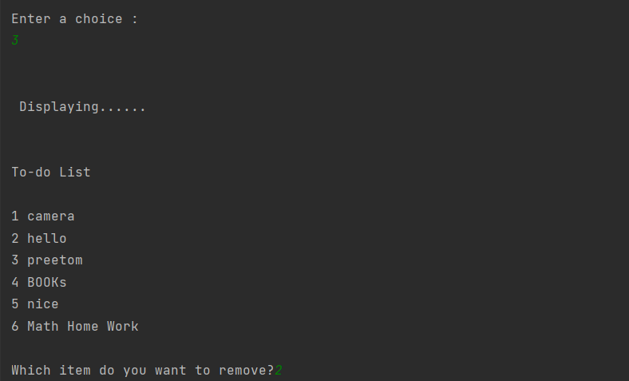
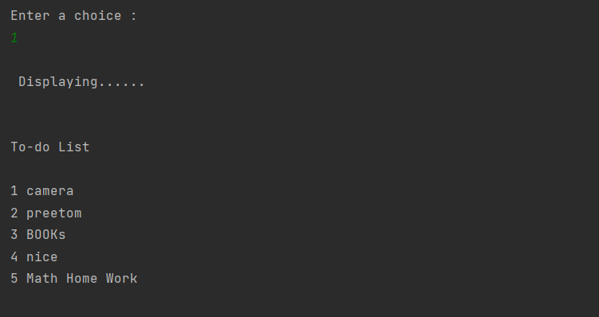
Remove item
After deleting item 2 from list

Slide 15
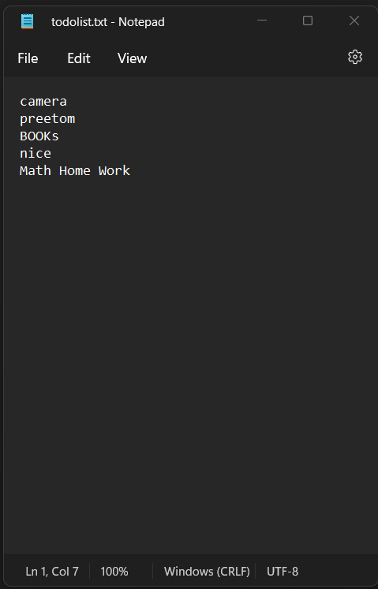
Item 2 deleted from file

Slide 16
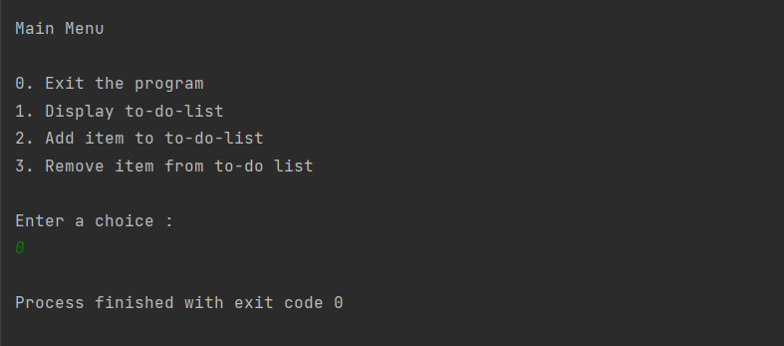
Exit the Program

Slide 17
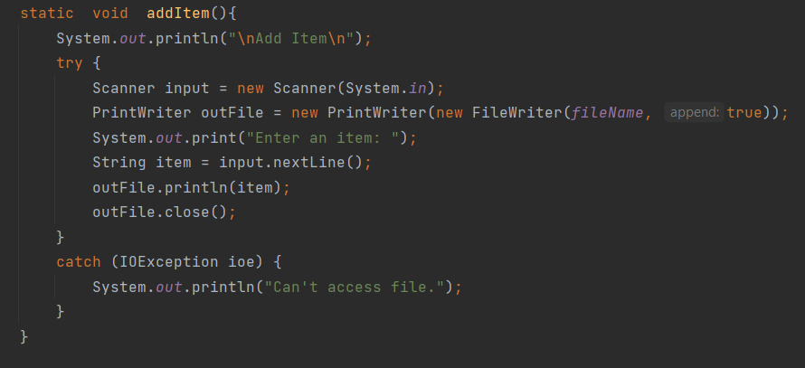
Error Handling
The exception handling in java is one of the most powerful mechanism to handle the runtime errors
So that the normal flow of the system can be maintained.
We used try-catch method for exception handling in our system.

Slide 18
Object Oriented Programming
Since Java is known as OOP language so the main aim of object-oriented programming is to implement real world entities. For example: Object, Classes, Abstraction, Inheritance, Polymorphism etc.
IN our project we have used some OOP features.
They are:
Class
Object
Inheritance

Slide 19
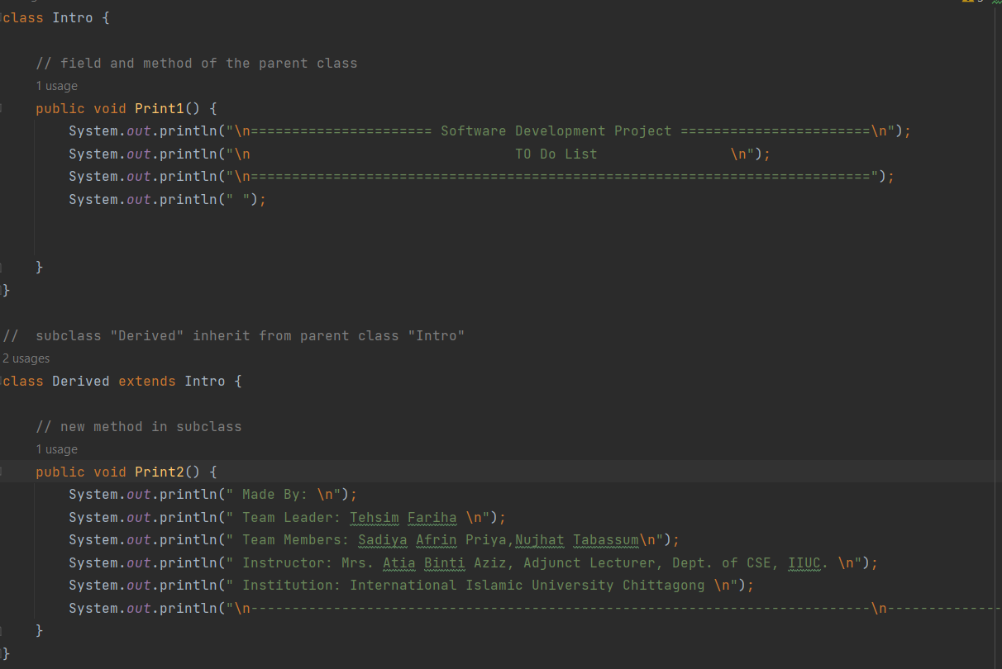
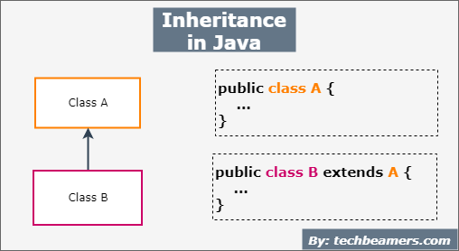
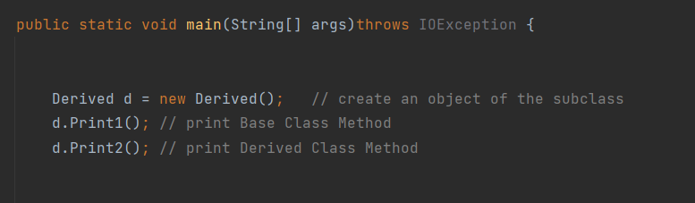
Inheritance

Slide 20
Limitation
Can’t delete the whole list at once
Don’t have search option

Slide 21
Future Scope
Application Based To-Do-List
Online Based To-Do-List
Deadlines for list items.
Review and revisit the list.
Calendar view.

Slide 22
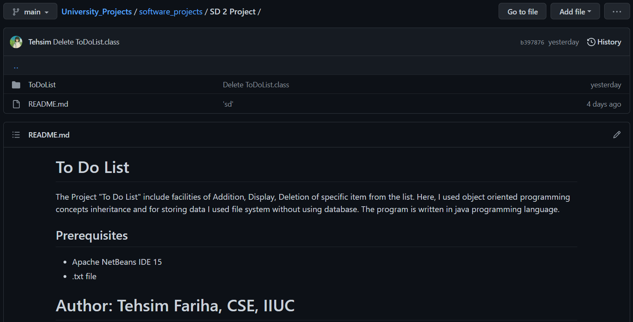
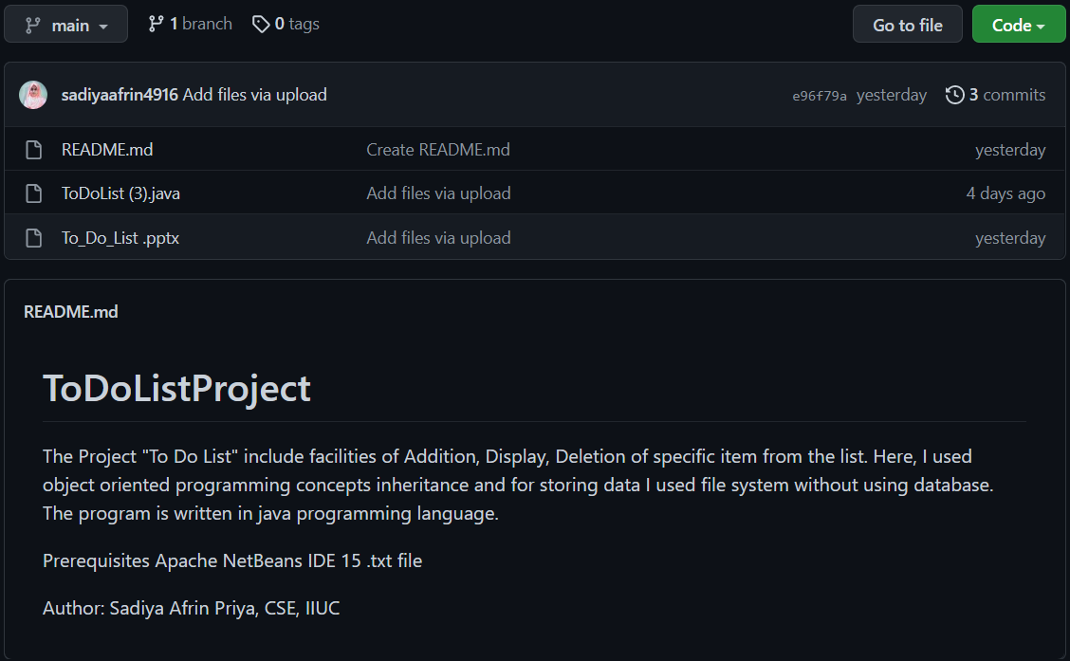
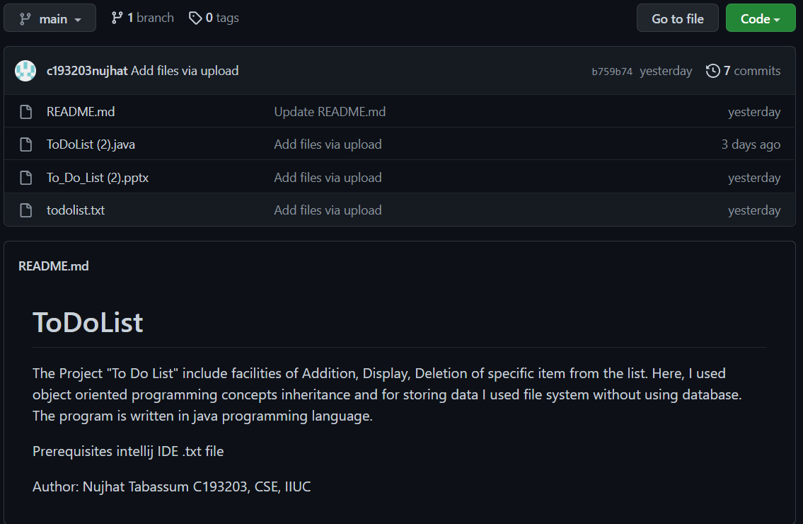
GitHub Link
https://github.com/Tehsim/University_Projects/tree/main/software_projects/SD%202%20Project
https://github.com/sadiyaafrin4916
https://github.com/c193203nujhat

Slide 23

Thank You

